Slide 1
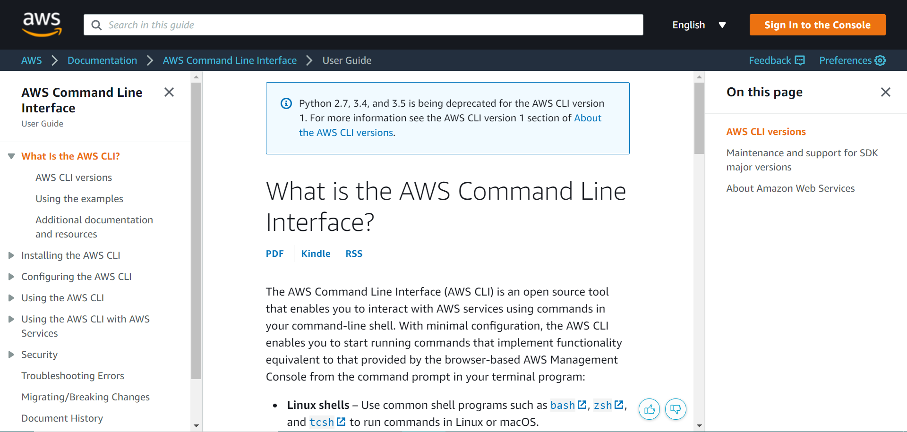

Slide 2
https://docs.aws.amazon.com/cli/latest/userguide/install-cliv2.html
Notes:
https://docs.aws.amazon.com/cli/latest/userguide/install-cliv2.html

